Slide 1
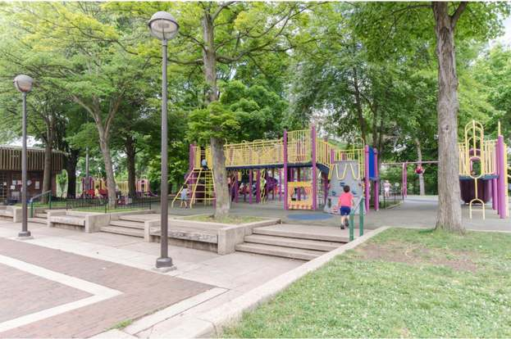
Schuylkill River Park Arboretum

Slide 2
What is an arboretum?
Arbor means tree, and an arboretum is a garden made up of trees. Schuylkill River Park has more than 50 different tree species, from the ball fields to the community garden, and a group of neighbors is working to make it an official arboretum.
And they want our help! They are working to include trees that have strong sensory traits – trees that appeal to our five senses (smell, touch, taste, sight, and sound). On the next five slides are five different species of trees that they are considering. Each offers one main sensory trait, and other characteristics are also included. Once you learn about them, you will have the chance to vote for your favorite. The tree with the most votes will get planted in the park this fall!

Slide 3

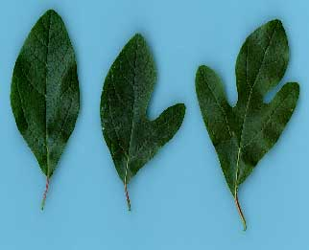
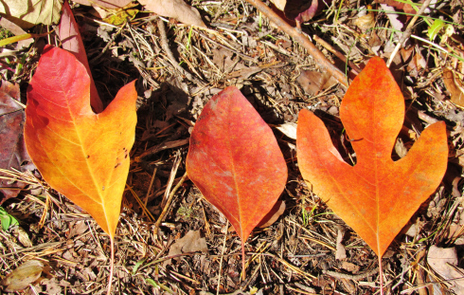
SASSAFRAS (scent)
Sassafras is known for its many smells. The bark smells like cinnamon, the roots smell like root beer, and the leaves smell like Fruit Loops!
The roots of the sassafras tree were once used to make root beer.
The tree has 3 different shaped leaves – the tongue, the mitten, and the ghost.
Sassafras trees turn bright yellow, orange, and red in the fall.

Slide 4
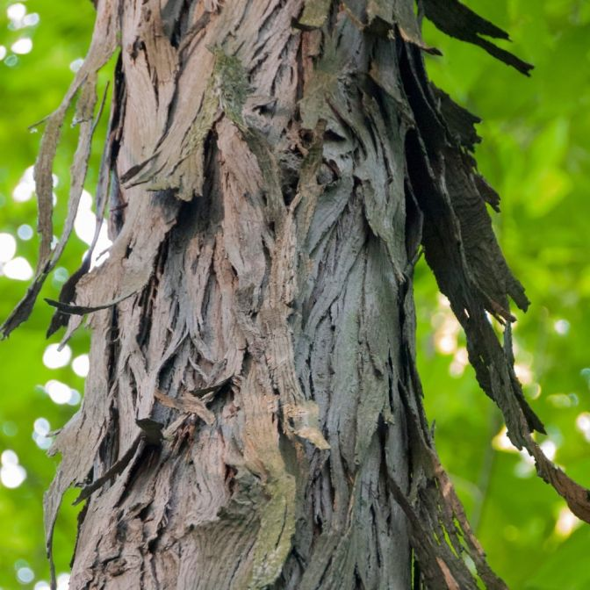
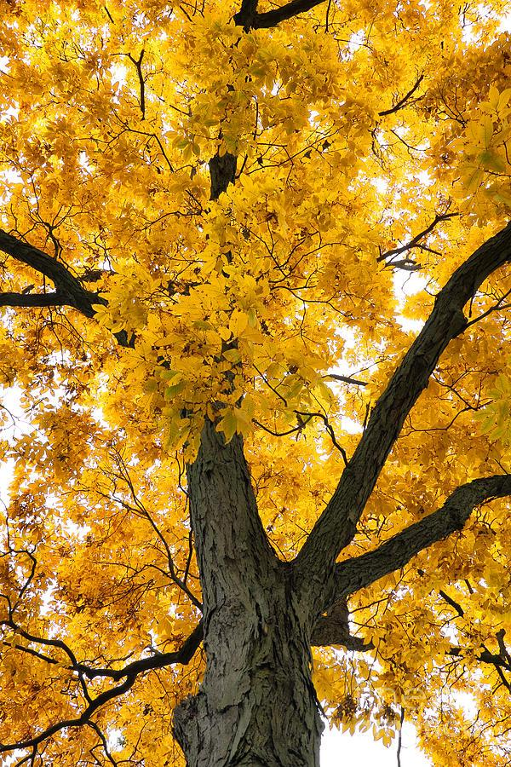

SHAGBARK HICKORY (sight)
The bark, like its name says, is shaggy and peely.
The leaves turn golden yellow in the fall.
Not this kind of Shaggy

Slide 5
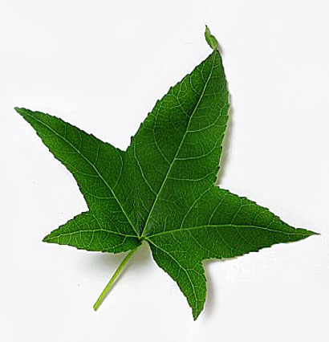
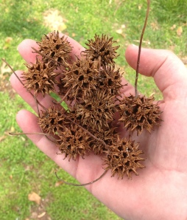
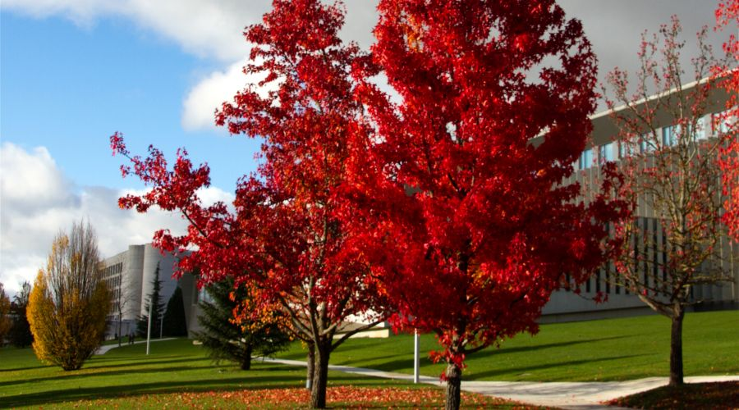
SWEETGUM (touch)
The seed pods are prickly and stick together like Velcro.
The sap of the tree was once used to flavor tobacco.
The leaves are shaped like stars.
The leaves turn yellow then purple then red in the fall.

Slide 6
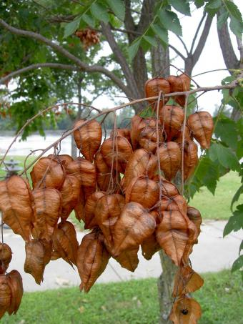
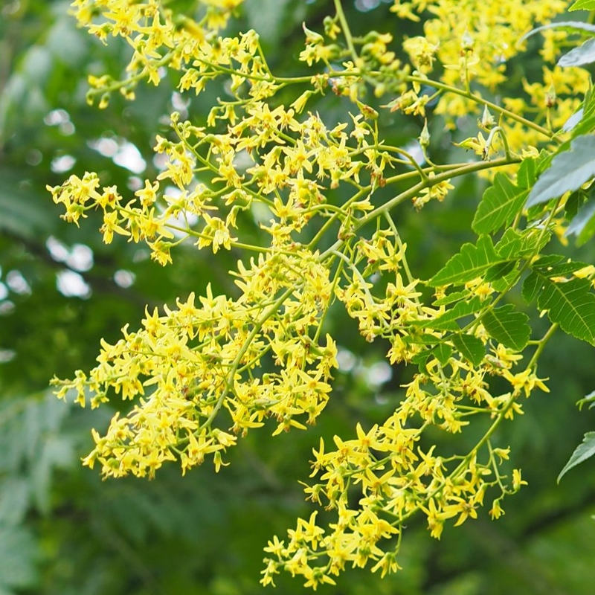
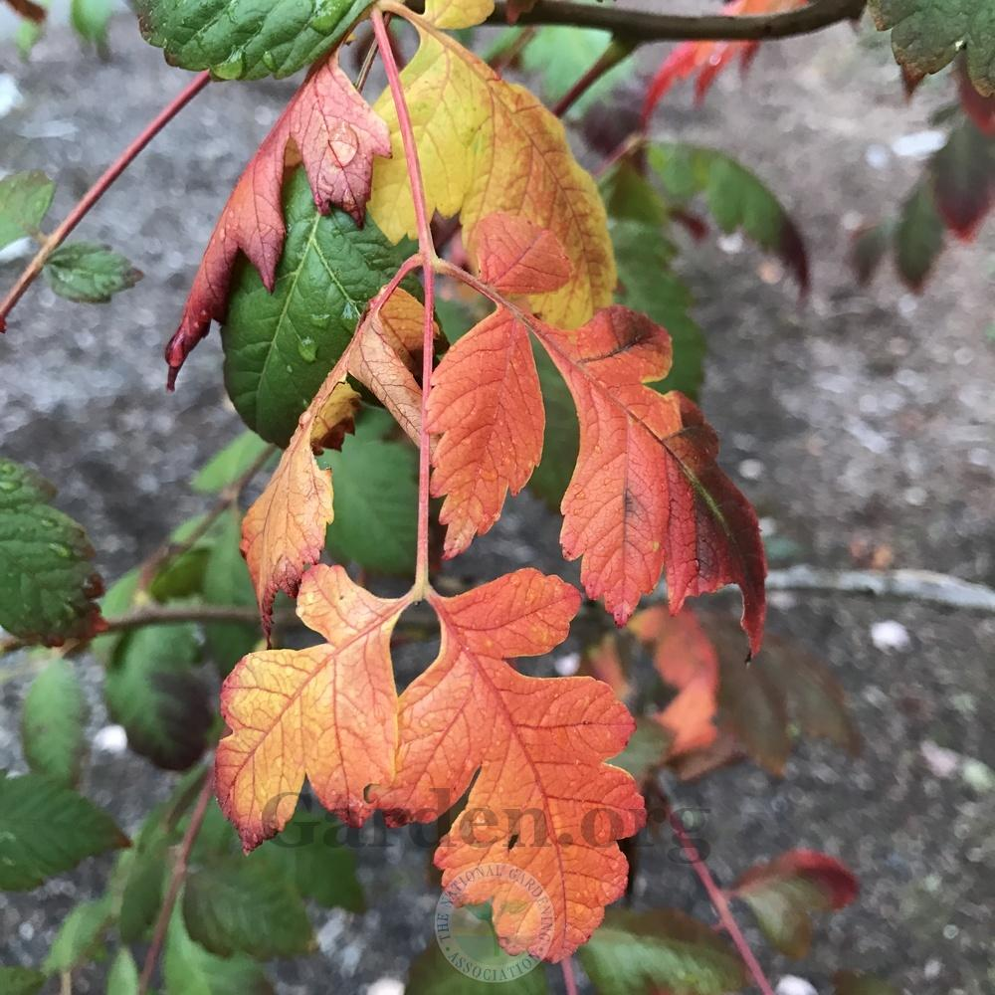
Golden Rain Tree (sound)
The dried seed pods make a rattling sound.
The tree produces large blooms of yellow flowers. This is where its name, “Golden Rain” comes from.
The leaves turn orangey-red in the fall.

Slide 7
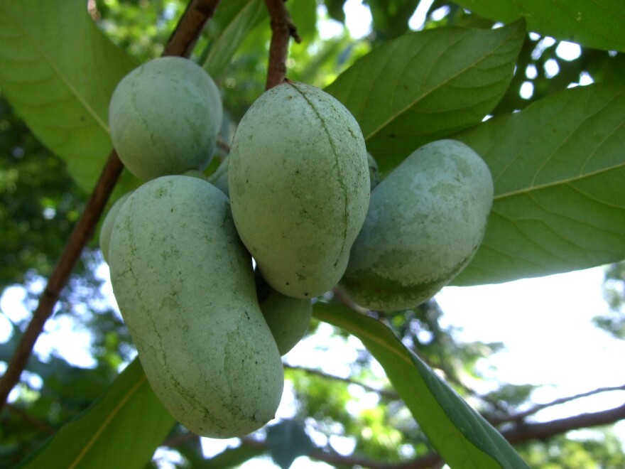
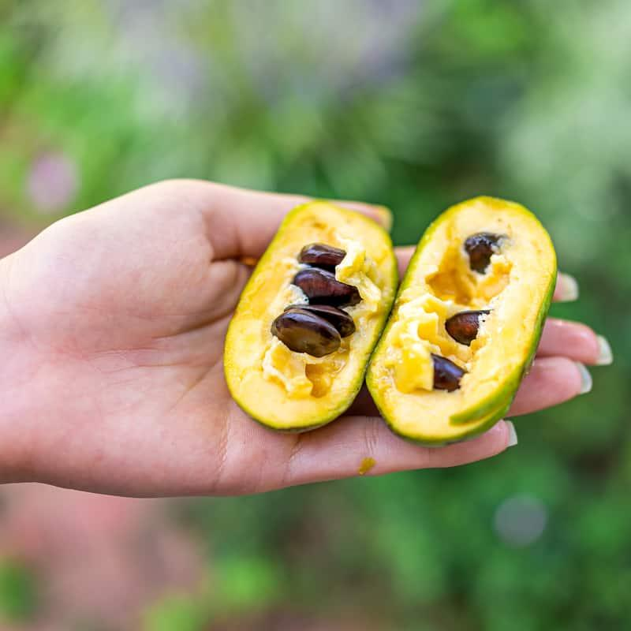
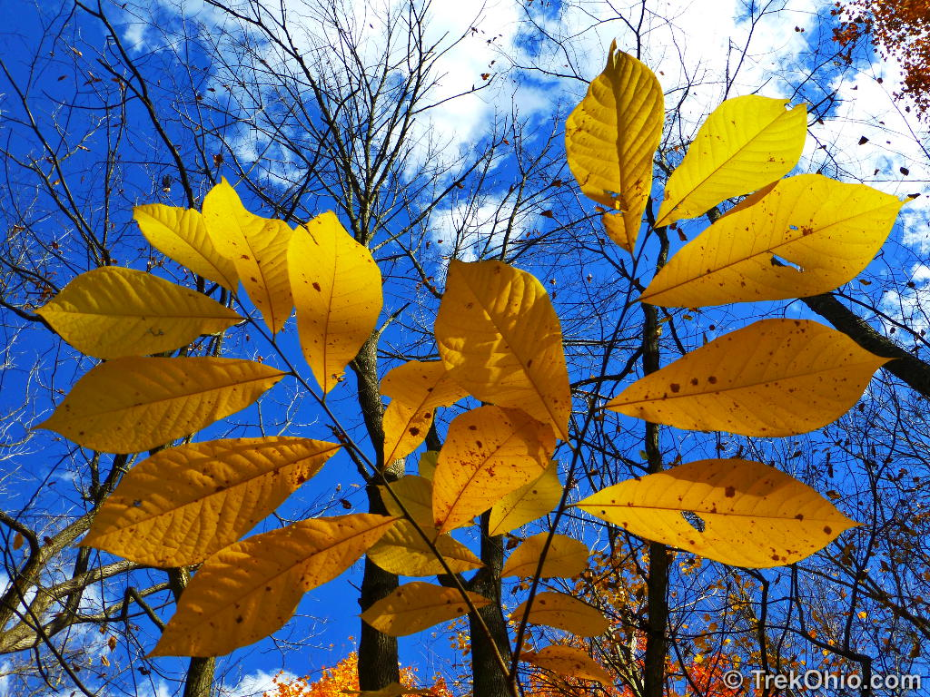
Pawpaw (taste)
You can eat the fruit!
The fruit tastes like a cross between mango and banana.
The name is fun to say.
It is the largest fruit tree native to North America.
The leaves turn yellow-orange in the fall.

Slide 8
Time to Vote!
Which tree you would like to see added to the Schuylkill River Park Arboretum. Which one do you think offers the best sensory experiences?
Sassafras (scent)
Shagbark Hickory (sight)
Sweetgum (touch)
Golden Rain Tree (sound)
PawPaw (taste)
When done, give your ballot to your teacher. The results will be announced soon!

